Slide 1
Statistical Modelling of City Bikes and Points of Interest (POIs)
Approach and findings
Goals
Process
Findings
Challenges
Future Goals

Slide 2
Goals
The project aim is to statistically model a relationship (if any) between city bike availability and Points of Interest (POIs) in the area.
Join bike and venue data, explore any relationships and model these with linear regression.
City chosen: Toronto, Ontario
Tools:
City Bike API (bike station data)
Foursquare API (venue/location data)
Yelp API (venue/location data)
See city_bikes.ipynb

Slide 3
Process
Foursquare's API used to obtain various places of interest in 800m (city density and constraints from API) of a city bike station
Began with a sample request of one bike station latitude/longitude location and manipulating the data returned by Foursquare
Number of bars/restaurants, parks, live venues and cafes, total number of POIs.
Sampled the Foursquare API calls on bike different stations to build a catch-all word search (Regex).

Slide 4
Process
For each of the 826 stations, Foursquare obtained up to 50 POIs in the bar/restaurant, park, cafe and live venue categories. Build the model and perform a linear regression later.
The individual venue data such as name, address, venue category for saving into a SQL .db file, as with the city bikes stations.
We now have a database holding tens of thousands venues and hundreds of bike stations, we can search by ll, search by bike station, search by venue where there is a bike station nearby.
EDA to find correlations between number of POIs, bike availability, correlation heatmaps and scatter graphs
See joining_data.ipynb.

Slide 5
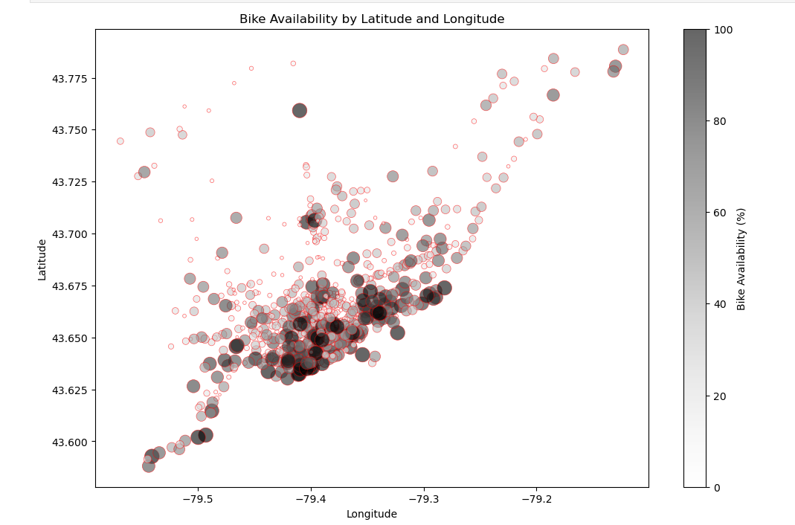
Findings
-0.51 corr between latitude and n_POIs
-0.31 corr between latitude and bike availability (image on right)
0.17 corr between n_POIs and bike availability
All three of the above are statistically significant (p <0.05)

Slide 6
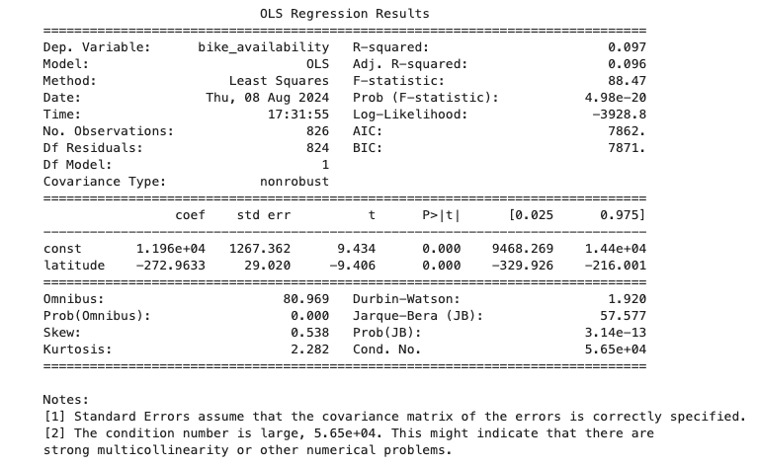
Findings
Simple linear regression:
Adjusted R² of 0.096 for bike availability / latitude. Latitude only explains 9.6% of the variance
Adjusted R² of 0.27 for n_POIs / latitude. Latitude only explains 27% of the variance of n_POIs. I expected higher because south is downtown, more densely packed than northern Toronto.
Multilinear regression: Adj. R² of 0.096 – predicting bike availability against latitude and n_POIs
Conclusion: Latitude and n_POIs do contribute to bike availability but they are by no means the only factors.
model_building.ipynb

Slide 7
Challenges
Avoiding multicollinearity in this is very difficult with n_POIs and bike availability/latitude
API is damaging the power of the n_POIs data, need > 50 returns. This impacted the radius that I was calling as well

Slide 8
Future Goals
Run the model on other categories of POI, or only with the specific categories. This would still have problems with collinearity though (in >= 50 POIs, more bars will mean less cafes are pulled)
Run the Monday afternoon data instead of Saturday afternoon for different findings?
Classification problem – categorize high and low density / high and low traffic stations and try and predict using other features in the data.
Use the n_POIs, bike availability and other features (Yelp distance from venue to bike station) to identify stations that are underserving the area – build more bike stations?

